Slide 1
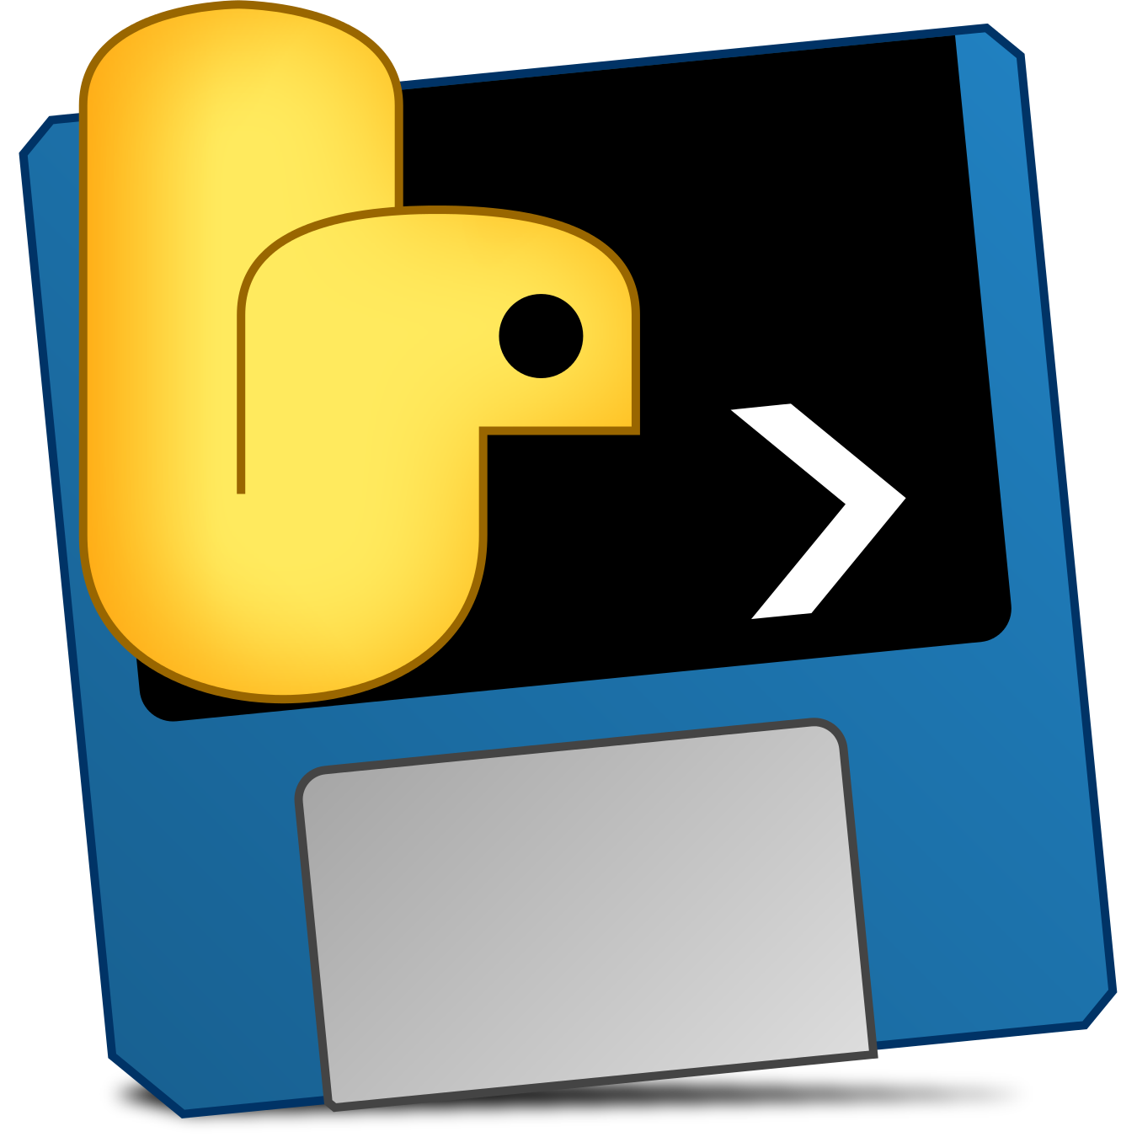
Packaging with PyInstaller
Michigan Python
@danyeaw

Slide 2
What PyInstaller Does
Analyzes your code for every module and library needed
Collects copies of all those files – including the active Python interpreter
Puts them with your app in a single folder, or optionally in a single executable file
PyInstaller calls this bundled app “frozen”
Dependencies
Your App
Python
Frozen App

Slide 3
How PyInstaller Finds Your Files
Searches all the import statements
It takes those imported modules and looks in them for import statements recursively, until it has a complete list of modules
It knows about common Python packages, including Qt for Python, WxPython, TkInter, PyGObject, matplotlib, and more

Slide 4
Some Dependencies are Tricky
Issues
__import__() function with variable data
Using importlib.import_module()
Manipulating sys.path at run time
Solutions
Just for you: Give additional imports when running PyInstaller
For everyone: “hook” files that inform PyInstaller of hidden imports

Slide 5
Bundling to One Folder
Default is to bundle to a single folder
All dependencies and the executable file exist in the folder
Easier to debug if there are issues
Zip the folder and give it to others or create an installer for others to use
Windows with NSIS or WiX
macOS dmg
Linux with Flatpak

Slide 6

How the One Folder Program Runs
The PyInstaller bootloader starts up Python and then your app
The bootloader creates a temporary Python environment such that the Python interpreter will find all imported modules and libraries
Binary executable for the active platform runs when the user launches your program

Slide 7
Bundling to One File
Bundle your script and all its dependencies into a single executable
One File One Program
A little slower to start up than the one-folder bundle
Harder to diagnose issues

Slide 8
How the One File Program Works
Contains an embedded archive of all the dependencies, as well as compressed copies of any non-Python support files
When started, creates a temporary folder in the appropriate temp-folder location for this OS
The bootloader uncompresses the support files and writes copies into the temporary folder, then it starts up like the one-folder app

Slide 9
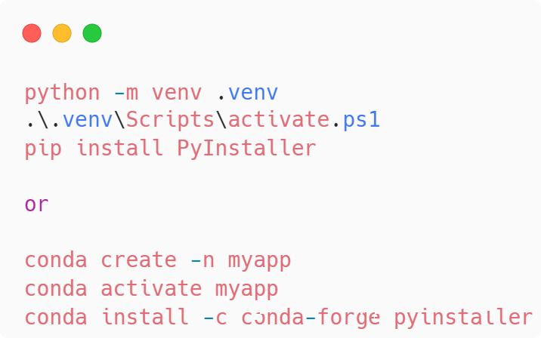
Install PyInstaller

Slide 10
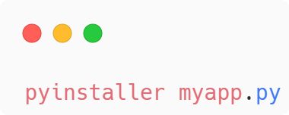
Execute PyInstaller
Creates a specification file
The spec file tells PyInstaller how to process your app
Encodes the script names and most of the options you give to the pyinstaller command into a Python file
PyInstaller builds the app by executing the spec file
For complex packaging, the spec file can be edited

Slide 11
PyInstaller in Action

